Slide 1
Timer

Slide 2
Basic Timer
A Timer/Counter can be configured in various modes, typically based on 8-bit or 16-bit operation. It is used to counter the number of input pulse.

Slide 3
Introduction
Timer
Set the initial value of registers (by software)
Start the timer (by software) and then the timer counts up.
Input from internal system clock (machine cycle)
When the timer : FFFF --> 0, the time sets a bit to denote time out.
Counter
Set the initial value of registers (by software)
Start the timer (by software) and then the PIC18 counts up.
Input from external signal
When the timer: FFFF --> 0, the timer sets a bit to denote time out.
3
Notes:
3

Slide 4
Introduction
- Time is represented by the count in a timer.
- There are many applications that cannot be implemented without a timer:
1. Event arrival time recording and comparison
2. Periodic interrupt generation
3. Pulse width and period measurement
4. Frequency and duty cycle measurement
5. Generation of waveforms with certain frequency and duty cycle
6. Event counting
4
Notes:
4

Slide 5
Introduction
PIC18 has two to five timers
Depending on the family number
These timers can be used as
Timers to generate a time delay
Counters to count events happening outside the PIC18
Every timer needs a clock pulse to tick
Clock source can be
Internal → 1/4th of the frequency of the crystal oscillator on OSC1 and OSC2 pins (Fosc/4) is fed into timer
External: pulses are fed through one of the PIC18’s pins → Counter
Timers are 16-bit wide (TMRxL & TMRxH)
Each timer has TCON (timer Control) reg.
5
Notes:
5

Slide 6
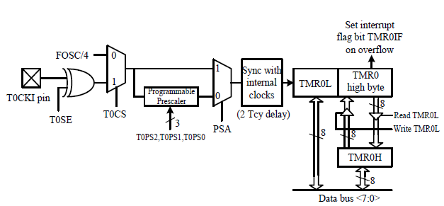
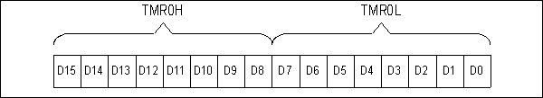
Timer0
- Can be configured as an 8-bit or 16-bit timer or counter.
- Can select the internal instruction cycle clock or the T0CKI signal as
the clock signal.
- The user can choose to divide the clock signal by a prescaler before
connecting it to the clock input to Timer0.
- The T0CON register controls the operation of Timer0.
6
Notes:
6

Slide 7
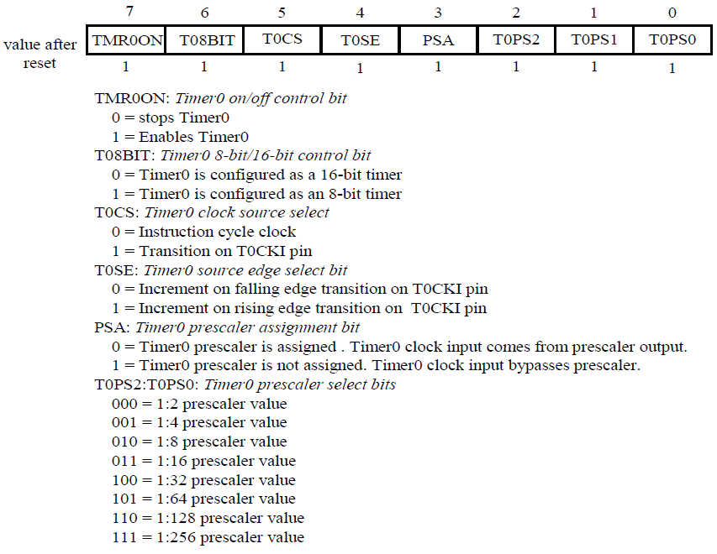
Timer0
7
Notes:
7

Slide 8
Example
Find the value for T0CON if we want to program Timer0 in 16-bit mode, no prescaler. Use PIV18 Fosc/4 crystal oscillator for the clock source, increment on positive-edge.
PSA=1,
T0CON=0000 1000
8
Notes:
8

Slide 9
Example
Find the timer’s clock frequency and its period for various PIC18-based systems, with the following frequencies. Assume that no prescaler is used.
10 MHz (2) 16 MHz (3) 4 MHz
¼ x 10 MHz = 2.5 MHz and T = 0.4 μs
¼ x 16 MHz = 4 MHz and T = 0.25 μs
¼ x 4 MHz and T = 1 μs
9
Notes:
9

Slide 10
Characteristics and operations of 16-bit mode
16-bit timer, 0000 to FFFFH.
After loading TMR0H and TMR0L, the timer must be started.
Count up, till it reaches FFFFH, then it rolls over to 0000 and activate TMR0IF bit.
Then TMR0H and TMR0L must be reloaded with the original value and deactivate TMR0IF bit.
10
Notes:
10

Slide 11
Steps to program Timer0 in 16-bit mode to generate time delay
Load the value into the T0CON register
Load reg. TMR0H followed by reg. TMR0L with initial value
Start the timer with instruction
BSF T0CON, TMR0ON
Keep monitoring the timer flag (TMR0IF) to see if it is raised.
Stop the timer
Clear the TMR0IF flag 3
Go Back to step 2
11
Notes:
11

Slide 12
Example
A square wave of 50% duty cycle on the PORTB.5 is created Analyze the program.
BCF TRISB,5 ;PB5 as an output
MOVLW 0x08 ;Timer0, 16-bit, int clk, no prescaler
MOVWF T0CON ; load T0CON reg.
HERE
MOVLW 0xFF ; TMR0H = FFH, the high byte
MOVWF TMR0H ; load Timer0 high byte
MOVLW 0xF2 ; TMR0L = F2H, the low byte
MOVWF TMR0L ; load Timer0 low byte
BCF INTCON, TMR0IF ; clear timer interrupt flag bit
BTG PORTB,5 ; toggle PB5
BSF T0CON, TMR0ON ; start Timer0
AGAIN
BTFSS INTCON, TMR0IF ; minitor Timer0 flag until
BRA AGAIN ; it rolls over
BCF T0CON, TMR0ON ; stop timer
BRA HERE ; load TH, TL again
12
Notes:
12

Slide 13
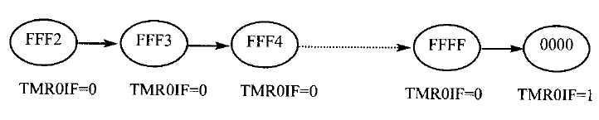
Example
Solution
T0CON is load.
FFF2H is loaded into TMR0H-TMR0L
The Timer0 interrupt flag is cleared by “BCF INTCON, TMR0IF”
PORTB.5 is toggled
Timer0 is started by “BSF T0CON, TMR0ON”
Timer0 counts up from FFF2H. Until it reaches FFFFH, one more clock rolls it to 0. Then Timer flag TMR0IF =1. At that point, the
“BTFSS INTCON, TMR0IF” instruction bypasses the “BRA AGAIN”.
Timer0 is stopped by the instruction “BCF T0CON, TMR0ON” and the
process is repeated.
13
Notes:
13

Slide 14
Example
In the previous example, calculate the amount of time delay generated the timer. Assume that the clock frequency is 10MHz.
Fosc/4 = 2.5 MHz. 1 MC =0.4μs.
FFFFH-FFF2+1=0EH=14.
14 x 0.4 = 5.6 μs.
Note: if the TMR0=XXXX, the number of MC is FFFFH+1-XXXXH
14
Notes:
14

Slide 15
Example
Calculate the frequency of the wave generated on PIN PORTB 5.
Assume that the clock frequency is 10MHz.
T=2x(48+16)x0.4 = 51.2μs and F=19.5 MHz
BCF TRISB,5 MOVLW 0x08 MOVWF T0CON BCF INTCON, TMR0IF HERE MOVLW 0xFF MOVWF TMR0H MOVLW -D'48' MOVWF TMR0L CALL DELAY BTG PORTB,5 BRA HERE DELAY BSF T0CON, TMR0ON AGAIN BTFSS INTCON, TMR0IF BRA AGAIN BCF T0CON, TMR0ON BCF INTCON, TMR0IF RETURN | 1 1 1 2 1 2 1 1 2 (usually) 1 1 2 --- 15
15
Notes:
15

Slide 16
Example
Calculate the frequency of the wave generated on PIN PORTB 5.
Assume that the clock frequency is 10MHz. Do not include the overhead due to instructions in the loop.
BCF TRISB,5 MOVLW 0x08 MOVWF T0CON HERE MOVLW 0x76 MOVWF TMR0H MOVLW 0x34 MOVWF TMR0L BCF INTCON, TMR0IF CALL DELAY BTG PORTB,5 BRA HERE DELAY BSF T0CON, TMR0ON AGAIN BTFSS INTCON, TMR0IF BRA AGAIN BCF T0CON, TMR0ON RETURN | FFFFH-7634H+1=89CCH=35276, Delay 35276x0.4=14.11ms, Period = 28.22 ms Frequency = 35.434 Hz
16
Notes:
16

Slide 17
Example
Assuming that clock = 10 MHz, write a problem to generate a square wave with period of 10ms on pin PORTB.3
T=10ms=> Delay = 5 ms. 5/0.4=12,500. 65,536-12,500=53,036=CF2CH.
TMR0H=CFH, TMR0L=2CH
BCF TRISB,3 MOVLW 0x08 MOVWF T0CON HERE MOVLW 0xCF MOVWF TMR0H MOVLW 0x2C MOVWF TMR0L BCF INTCON, TMR0IF CALL DELAY BTG PORTB,3 BRA HERE DELAY BSF T0CON, TMR0ON AGAIN BTFSS INTCON, TMR0IF BRA AGAIN BCF T0CON, TMR0ON RETURN | Modify the program to get the lowest frequency. If we set TMR0 = 0000H, the delay generated is 65536 MC, The delay is 26.214 ms. The smallest frequency is 1/(52.428ms) = 19.074 Hz.
17
Notes:
17

Slide 18
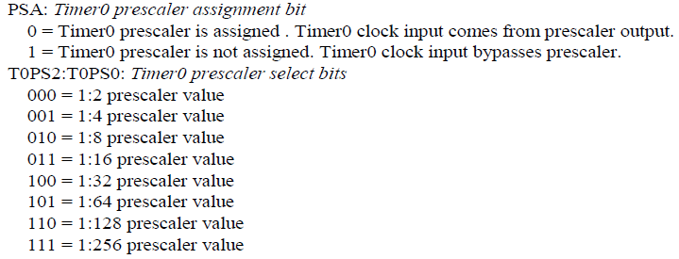
Prescaler and generating larger delay
The size of delay depend on
The Crystal frequency
The timer’s 16-bit register.
The largest timer happens when TMR0L=TMR0H=0
Prescaler option is used to duplicate the delay by dividing the clock by a factor of 2,4, 8,16, 32,64 ,128,256
If T0CON=0000 0101, then T = 4*64/f

Slide 19
Example
Examine the following program and find the time delay in second and frequency of the wave generated. Assume that XALT = 10 MHz.
BCF TRISB,2 MOVLW 0x05 MOVWF T0CON HERE MOVLW 0x01 MOVWF TMR0H MOVLW 0x08 MOVWF TMR0L BCF INTCON, TMR0IF CALL DELAY BTG PORTB,2 BRA HERE DELAY BSF T0CON, TMR0ON AGAIN BTFSS INTCON, TMR0IF BRA AGAIN BCF T0CON, TMR0ON RETURN | Prescaler=64. TMR0=0108H=264, 65536-264=65272. Now 65273x (64x0.4 μs)=1.671 s. The frequency is 1/(2x1.671) Hz If presclar 256 is chosen, the prescaler clock period to the timer is 0.4 μs x 256 = 1.024 ms. The largest delay is 67 seconds. How to generate a longer delay? Hint: call a delay routine a number of times by a loop.
19
Notes:
19

Slide 20
Example
Write a program to generate a square wave of 50Hz on pin PORTB.7. Use Timer0, 16 bit model with prescaler = 128. Assume that XALT = 10 MHz.
BCF TRISB,7 MOVLW 0x06 MOVWF T0CON HERE MOVLW 0xFF MOVWF TMR0H MOVLW 0x3D MOVWF TMR0L BCF INTCON, TMR0IF CALL DELAY BTG PORTB,7 BRA HERE DELAY BSF T0CON, TMR0ON AGAIN BTFSS INTCON, TMR0IF BRA AGAIN BCF T0CON, TMR0ON RETURN | F=50Hz, T=20ms Delay=10 ms 10ms/0.4 μs/128=195 65536-195=65341=FF3D TL=3D and TH =FF
20
Notes:
20

Slide 21
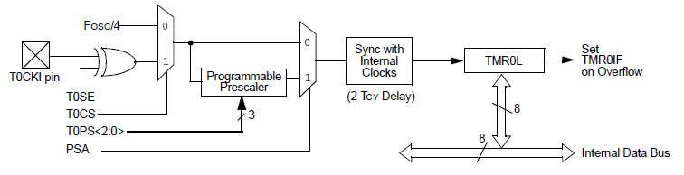
Timer0 8-bit
Load the T0CON value
Load TMR0L only.
Start timer
Keep monitor the timer flag (TMR01F)

Slide 22
Example
Assume that XTAL=10 MHz, find (a) the frequency of the square wave generated on PORTB.0 in the following program, and (b) the smallest frequency acheivable in this program, and the TH value to do that
BCF TRISB,0 MOVLW 0x48; no prescalar MOVWF T0CON BCF INTCON,TMR0IF HERE MOVLW 0x5 MOVWF TMR0L CALL DELAY BTG PORTB,0 BRA HERE DELAY BSF T0CON,TMR0ON AGAIN BTFSS INTCON,TMR0IF BRA AGAIN BCF T0CON,TMR0ON BCF INTCON,TMR0IF RETURN | (256-5) =251x0.4 = 100.4 μs is the half period. So the period is 200.8μs, and the freq is 4.98 kHz. To get the smallest freq, we set TMR0L=00. In this case T=256x0.4x2=204.8 μs. The freq is is 4,882.8 KHz
22
Notes:
22

Slide 23
Assembler and negative value
MOVLW –D’200’
MOVWF TMR0L
is identical to move 38H into TMR0L. Then FFH-38H + 1 = 200₁₀
Assume 10 MHz
BCF TRISB,3 BCF INTCON,TMR0IF MOVLW 0x48 MOVWF T0CON HERE BSF PORTB,3 CALL DELAY CALL DELAY BCF PORTB,3 CALL DELAY BRA HERE DELAY MOVLW -D'150' MOVWF TMR0L BSF T0CON,TMR0ON AGAIN BTFSS INTCON,TMR0IF BRA AGAIN BCF T0CON,TMR0ON BCF INTCON,TMR0IF RETURN | Delay == 150 MC = 150x0.4=60μs High portion + low portion = 180 μs. Freq= 5.5555KHz.
23
Notes:
23

Slide 24
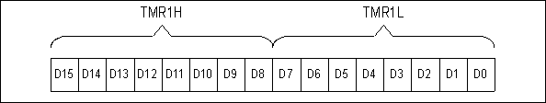
Timer1
Can be programmed in 16-bit mode only
It has 2 bytes named as TMR1L and RMR1H
It has also T1CON and TMR1IF
The module incorporates its own low-power oscillator to provide an additional clocking option.
Used as a low-power clock source for the microcontroller in power-managed operation.

Slide 25
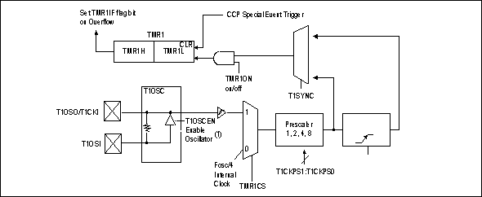
Timer1 Block Diagram

Slide 26
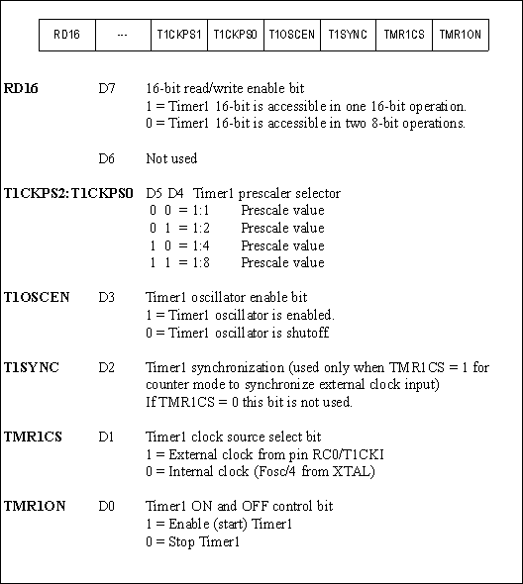
T1CON (Timer 1 Control ) Register

Slide 27
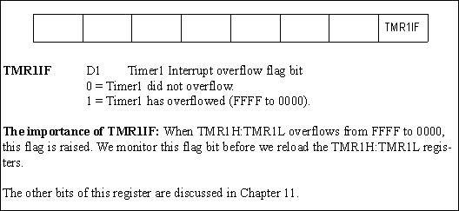
PIR1 (Interrupt Control Register 1) Contains the TMR1IF Flag

Slide 28
Example
Write a program to generate a square wave of 50Hz on PORTB.5. Use Timer 1 in 16-bit mode with the maximum prescaler. Assume that the clock frequency is 10MHz.
BCF TRISB,5 MOVLW 0x30 MOVWF T1CON HERE MOVLW 0xF3 MOVWF TMR1H MOVLW 0xCB MOVWF TMR1L BCF PIR1, TMR1IF CALL DELAY BTG PORTB,5 BRA HERE DELAY BSF T1CON, TMR1ON AGAIN BTFSS PIR1, TMR1IF BRA AGAIN BCF T1CON TMR1ON RETURN | F=50Hz, T=20ms Delay=10 ms 10ms/0.4 μs/8=3125=C34H FFFF-C34H+1=F3CBH TL=CBH and TH =34H
2828
Notes:
28

Slide 29
Counter Programming
Used to counts event outside the PIC
Increments the TMR0H and TMR0L registers
T0CS in T0CON reg. determines the clock source,
If T0CS = 1, the timer is used as a counter. TMR0 count up (NOT count down)
Counts up as pulses are fed from pin RA4 (T0CKI)
What does T0CON=0110 1000 mean?

Slide 30
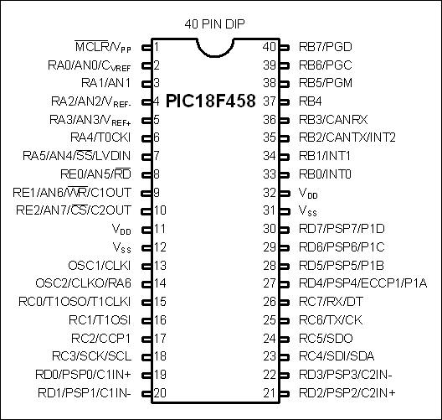
Using external Crystal for Timer clock
Timer0 comes with two options,
clock fed into T0CKI
T0CS=0
Clock from a crystal
T0CS=1

Slide 31
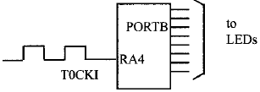
Example
Assuming that a signal is fed into pin T0CK1, write a program for counter 0 in 8-bit mode to count the pulses and display the state of the TMR0L count on PORTB.
BSF TRISA,RA4 ;PORTA.4 as external input for timer0 CLRF TRISB MOVLW 0x68 ; control word for timer0, 8 bit and counter model MOVWF T0CON HERE MOVLW 0x0 ; TMR0L=0 MOVWF TMR0L BCF INTCON,TMR0IF BSF T0CON,TMR0ON AGAIN MOVFF TMR0L,PORTB BTFSS INTCON,TMR0IF BRA AGAIN BCF T0CON,TMR0ON GOTO HERE
Notes:
31

Slide 32
Timer 1
Notes:
32

Slide 33

Example
Assuming that a signal is fed into pin T1CKI, write a program for counter 1 to count the pulses and display the state of the count on PORTB and C
BSF TRISC,RC0 ;PORTC.0 as external input for timer0 CLRF TRISB CLRF TRISD MOVLW 0x02 ; control word for timer1 MOVWF T1CON HERE MOVLW 0x0 ; TMR1L=0 MOVWF TMR1L MOVWF TMR1H BCF PIR1,TMR1IF BSF T1CON,TMR1ON AGAIN MOVFF TMR1L,PORTB MOVFF TMR1H,PORTD BTFSS PIR1,TMR1IF BRA AGAIN BCF T1CON,TMR1ON GOTO HERE
Notes:
33

Slide 34
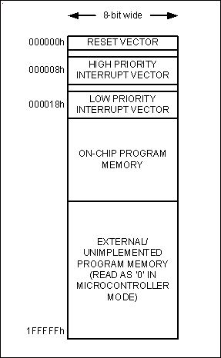
Timer Interrupt
When roll over occur,
the circuit set TMR0IF and generate a
timer interrupt.

Slide 35

INTCON
ENABLES
FLAGS
• GP port change interrupt
• GP port change interrupt
global interrupt
enable
• INT pin interrupt
• TMR0 overflow interrupt
• INT pin interrupt
• TMR0 overflow interrupt

Slide 36
Timer Interrupts
Interrupt | Flag Bit | Register | Enable Bit | Register
Timer0 | TMR0IF | INTCON | TMR0IE | INTCON
Timer1 | TMR1IF | PIR1 | TMR1IE | PIE1
Timer2 | TMR2IF | PIR1 | TMR3IE | PIE1
Timer3 | TMR3IF | PIR3 | TMR3IE | PIE2
Timer Interrupt Flag Bits and Associated Registers
INTCON Register with Timer0 Interrupt Enable and Interrupt Flag

Slide 37
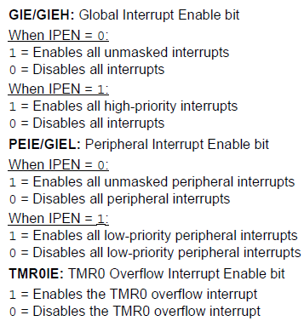
Timer Interrupts

Slide 38
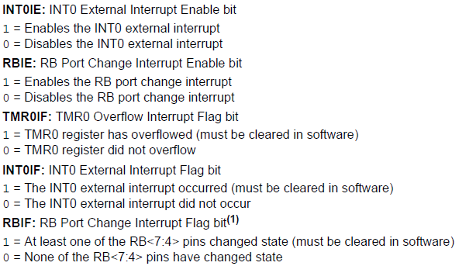
Timer Interrupts

Slide 39
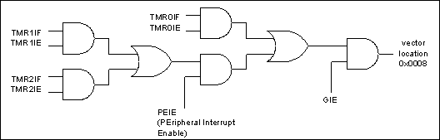
Timer Interrupts

Slide 40
Program
ORG 0000H
GOTO MAIN
ORG 0008H
BTFSS INTCON,TMR0IF
RETFIE
GOTO T0_ISR
ORG 00100H
MAIN BCF TRISB,5
CLRF TRISD SETF TRISC MOVLW 0x08 MOVWF T0CON
MOVLW 0xFF MOVWF TMR0H
MOVLW 0xF2 MOVWF TMR0L
BCF INTCON,TMR0IF
BSF T0CON,TMR0ON BSF INTCON,TMR0IE BSF INTCON,GIE
OVER MOVFF PORTC,PORTD
BRA OVER
T0_ISR
ORG 200H
MOVLW 0xFF MOVWF TMR0H MOVLW 0xF2 MOVWF TMR0L BTG PORTB,5 BCF INTCON,TMR0IF
RETFIE
END
Timer0 Interrupt

Slide 41
Example
Use Timer0 and Timer1 interrupts to generate square waves on pins RB1 and RB7 respectively, while data is being transferred from PORTC to PORTD.
ORG 0000H GOTO MAIN ORG 0008H GOTO CHK_INT ORG 0040H CHK_INT BTFSC INTCON,TMR0IF CALL T0_ISR BTFSC PIR1,TMR1IF CALL T1_ISR RETFIE ORG 0100H MAIN BCF TRISB,1 BCF TRISB,7 CLRF TRISD SETF TRISC MOVLW 0x08 MOVWF T0CON MOVLW 0xFF MOVWF TMR0H MOVLW 0xF2 MOVWF TMR0L BCF INTCON,TMR0IF | MOVLW 0x0 MOVWF T1CON MOVLW 0xFF MOVWF TMR1H MOVLW 0xF2 MOVWF TMR1L BCF PIR1,TMR1IF BSF INTCON,TMR0IE BSF PIE1,TMR1IE BSF INTCON,PEIE BSF INTCON,GIE BSF T0CON,TMR0ON BSF T1CON,TMR1ON OVER MOVFF PORTC,PORTD BRA OVER | T0_ISR ORG 200H MOVLW 0xFF MOVWF TMR0H MOVLW 0xF2 MOVWF TMR0L BTG PORTB,1 BCF INTCON,TMR0IF RETURN T1_ISR ORG 300H MOVLW 0xFF MOVWF TMR1H MOVLW 0xF2 MOVWF TMR1L BTG PORTB,7 BCF PIR1,TMR1IF RETURN END
Notes:
41

